Slide 1
Displaying Data with Tables

Slide 2

Overview
Defining tables
Working with data in tables Formatting tables

Slide 3
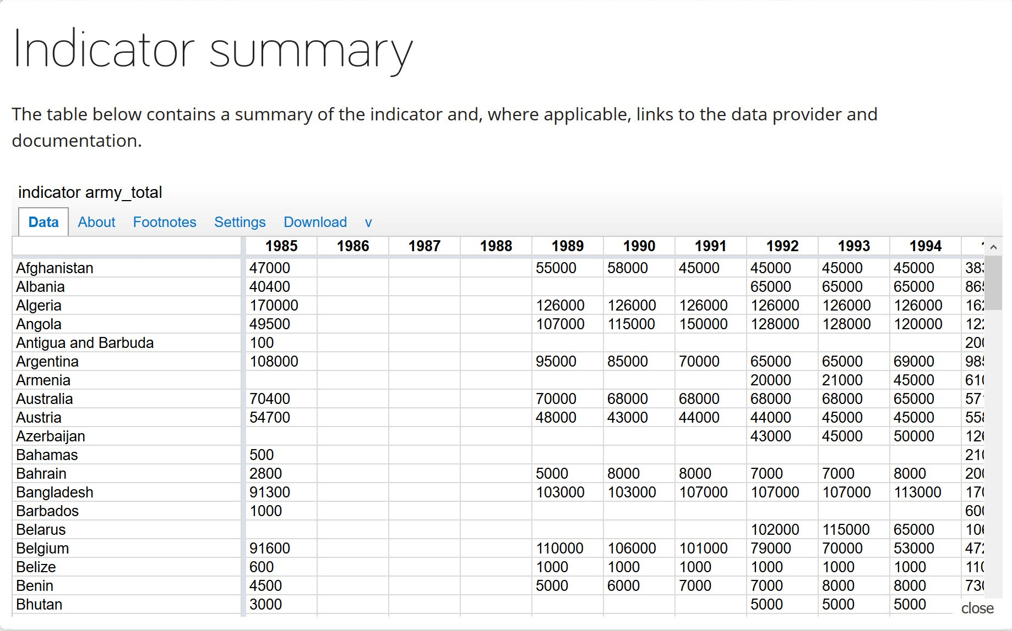
Tables Are for Data
https://www.gapminder.org/data/

Slide 4
Defining Tables
Caption Header
Data Table
Body
Footer

Slide 5
Structuring Data with Rows and Columns
<TR> Table Row
<TH> Table Header
<TD> Table Data
colspan / rowspan

Slide 6

Formatting Tables - Not Tables for Formatting
Use CSS to style tables
Control spacing, borders, padding, etc.

Slide 7
Summary
Tables are for displaying data
- Not for formatting HTML documents
Header and footer provide context Rows and cells present data
Help make tables accessible

